Slide 1
Fabric proof of concept
Translating spreadsheet logic into a governed execution pattern

Slide 2
Contents
Problem framing
Hypothesis and success criteria
Options considered
Chosen approach
Architecture
Evidence
Learnings
Implications
Next steps

Slide 3
Spreadsheet logic can move into Fabric without losing control

Slide 4
A manual spreadsheet process was becoming difficult to scale
Business logic sat inside spreadsheets rather than a managed execution layer
Files required manual handling before they could enter the data platform
Auditability and repeatability were weaker than the target operating model required
The key question was whether Fabric notebooks could preserve the logic while improving control

Slide 5
The PoC had to prove both logic fidelity and platform fit
Translate spreadsheet logic into Python notebooks accurately
Run the process cleanly inside a Fabric and lakehouse pattern
Improve repeatability across ingestion and execution
Strengthen visibility without adding unnecessary complexity

Slide 6
Several paths existed, but only one balanced control and repeatability
Retain spreadsheet execution
Automate around the spreadsheet
The decision was not whether change was possible
It was which execution model created the strongest operational footing
Translate logic into Fabric notebooks

Slide 7
The chosen approach moved logic into Python notebooks
The spreadsheet was treated as logic to be translated rather than simply automated around
Fabric notebooks became the execution surface for that logic
The surrounding flow was designed to support controlled ingestion into the lakehouse

Slide 8
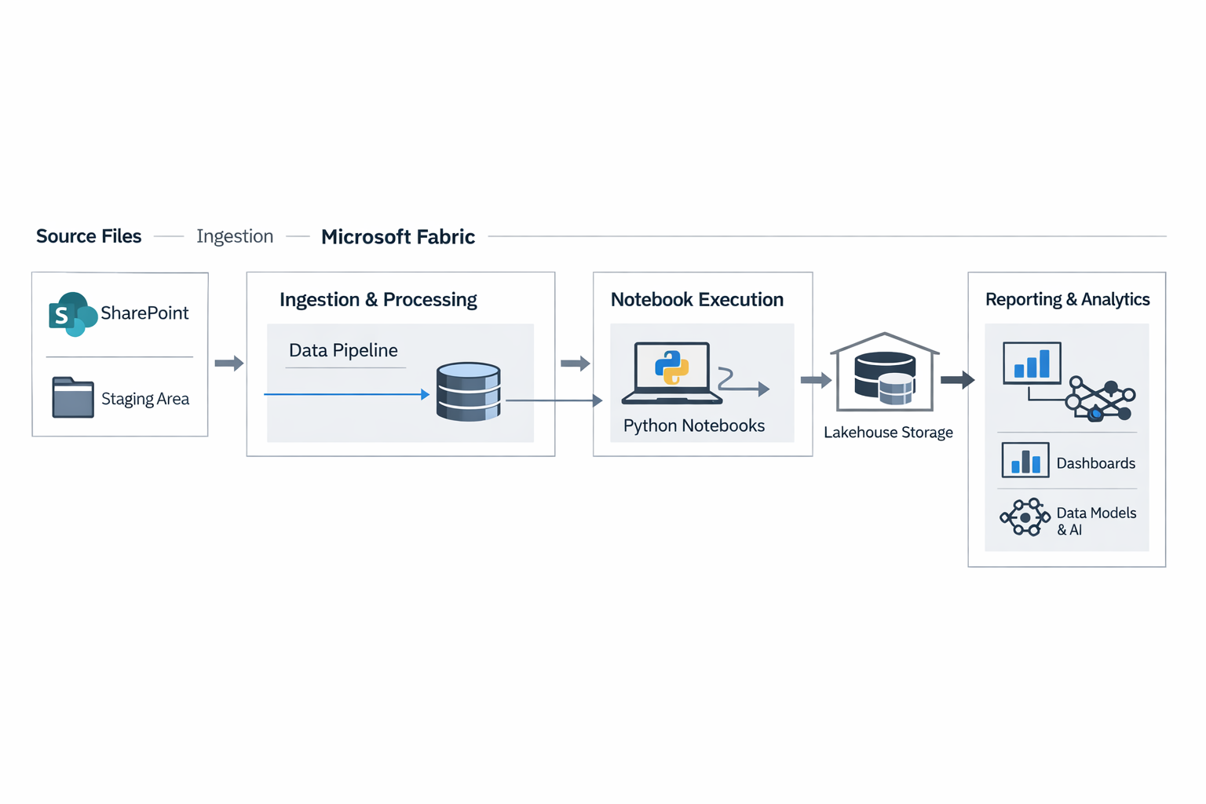
Architecture: spreadsheet ingestion and notebook execution in Fabric
Files move through a controlled ingestion path
Python notebooks execute the translated business logic inside Fabric
Outputs land in the lakehouse for reporting and downstream reasoning

Slide 9
The PoC proved the logic could move into Fabric cleanly
The notebook pattern was workable, governed and better aligned to repeatable processing.
Spreadsheet logic translated successfully into Python notebooks
Fabric operated effectively as the execution layer
The pattern created a stronger footing for automation and reporting

Slide 10
The main lessons were about process discipline and dependency
The harder problem was surfacing implicit spreadsheet assumptions, not notebook execution
Human intervention still mattered at the ingestion boundary where source quality varied
Folder and metadata handling mattered more than expected in making the flow reliable
A controlled trigger point was better than forcing full end-to-end automation too early

Slide 11
The result supports a move to platform-managed execution
The logic no longer needs to remain trapped inside a manually operated spreadsheet
Fabric can act as both an execution environment and a bridge into more governed data handling
Future automation should focus on reliable ingestion conditions rather than forced autonomy

Slide 12
The next step is to operationalise the pattern properly
Refine ingestion controls
Harden notebook execution
Extend lakehouse outputs
Connect into reporting

Slide 13
Thank you
David Rowley | IBM Consulting

